Slide 1
Methodological Approaches of Bulgaria

Slide 2
Geographical peculiarities of the Bulgarian part of the Black Sea region (GSA 29)
The distinctive physical and ecological features of the Bulgarian Black Sea coast influence its fisheries. These characteristics influence species composition, fishing practices, and management strategies.
Gographical and environmental features
The length of coastline is approximately 354 km.
The Bulgarian Black Sea possesses an extensive and relatively shallow continental shelf, making it suitable for demersal and pelagic fisheries.
Depths vary from nearshore shallows (<10 m) to offshore areas surpassing 100 m within Bulgaria's Exclusive Economic Zone (EEZ).
The seabed includes sandy and muddy substrates, critical for survival and development of various benthic species.
Major freshwater contributions arise from the Danube (indirectly through currents), Kamchia, and Ropotamo rivers, supplying nutrients and affecting salinity.

Slide 3
Environmental Conditions
Environmental Conditions
Salinity: Low salinity (~18-19 PSU) compared to other Eropean seas and open oceans, influenced by freshwater inflows.
Temperature: The Black Sea exhibits considerable regional and temporal variations in water temperature, affected by seasonal, geographic, and climatic factors. Surface temperatures along the Bulgarian coast fluctuate from 4–7°C in winter and 24–28°C in summer, with shallow coastal regions occasionally surpassing 30°C during heatwaves..
Oxygen Dynamics:
The Black Sea experiences hypoxic (low oxygen) zones below 150-200 m due to stratification and limited water exchange with the Mediterranean Sea.
Bulgarian fisheries operate above these anoxic depths.

Slide 4
Fisheries-Specific Characteristics
Pelagic Species (surface-dwelling):
Sprat (Sprattus sprattus): A key species for industrial and human consumption fisheries.
European anchovy (Engraulis encrasicolus): The most significant commercial species; forms large schools in coastal waters.
Horse mackerel (Trachurus mediterraneus): Common in spring and autumn migrations.
Bonito (Sarda sarda): Seasonal occurrence, mostly targeted by artisanal fisheries.
Demersal Species (bottom-dwelling):
Turbot (Scophthalmus maximus): High-value species, subject to strict quotas.
Whiting (Merlangius merlangus): Common in deeper waters.
Gobies (Gobiidae spp): Targeted by small-scale fisheries.
Other Species:
Mediterranean mussel (Mytilus galloprovincialis): Collected via aquaculture and natural beds.
Rapana whelk (Rapana venosa): An invasive species, commercially harvested for export.
Fishing Gear and Practices
Trawls: Primarily used for sprat and demersal species.
Gillnets: Widely used for turbot and other high-value fish.
Stationary trap pound nets; Purse seines: Target pelagic species like anchovy and horse mackerel.

Slide 5
Biological monitoring (Landings)
Data Collection
Biological data collection is based on statistically robust sampling strategy (from commercial catches) aiming at temporal stratification (monthly, seasonal) and specific Gear type (OTM) sampling.
The sampling processing Includes length and weight measurements, sex, age and maturity determination and biological potentials and parameters of target species like growth models (LWR, Fulton condition factor and individual growth parameters) which on a broader scale are helping to determine the current state of the population/stock.
The size and weight measurements, along with age determination of the samples, are being utilized to ascertain the size and age structure of the stocks, while sex determination is employed to establish the sex structure accordingly.
The assessment of maturity, taking into account factors such as seasonality and recruitment, facilitates inferences regarding species succession, development, and fisheries/gear selectivity.

Slide 6
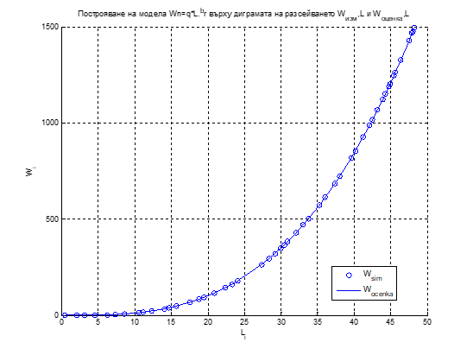
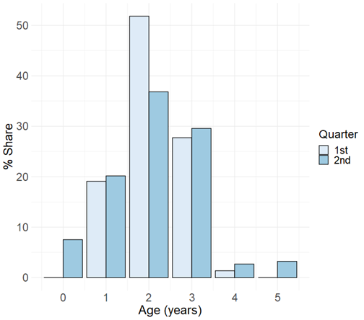
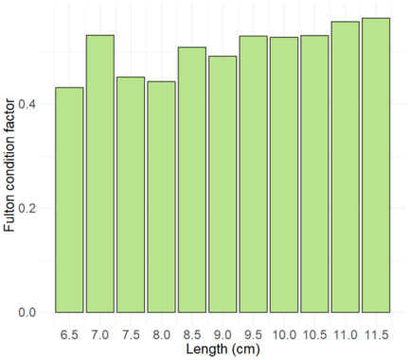
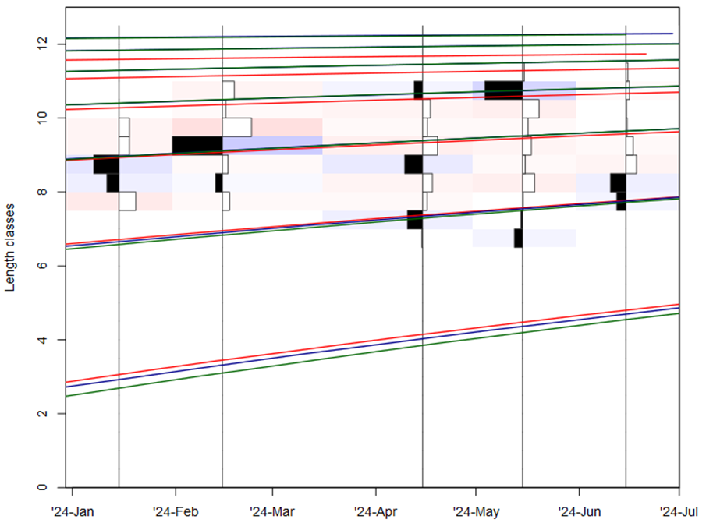
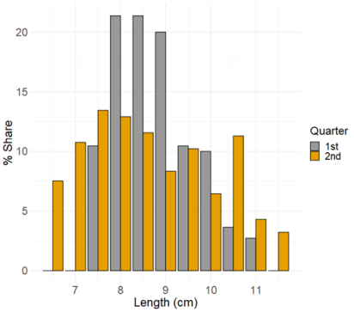
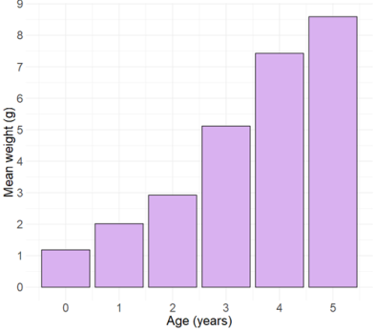
Biological sampling of landings
Size/age distribution
Bulgaria GSA 29
Sampling scheme
Monthly/seasonally for migratory species
3 readers (direct otolith reading)
CV
Evaluation of method - accuracy
Age slicing (ELEFAN RSA, SA and GA) as a supplementary validation to otolith readings and tool for von Bertalanffy growth parameters estimation followed by consequent construction of ALK
LWR
Length and weight measurements: to the nearest 0.5 cm (L), w→0.01g

Slide 7
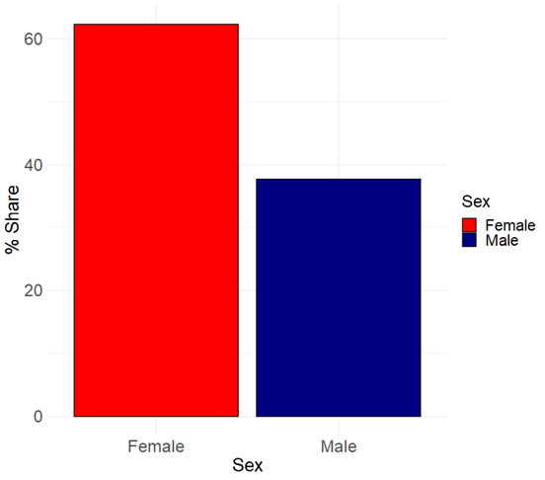
Biological sampling of landings
Maturity and Sex determination
Bulgaria GSA 29
Sampling scheme
Monthly/seasonally for migratory species
Method
macroscopically
Sex determination
Evaluation of method - accuracy
3 experts (maturity and sex determination)
CV
Maturity stage according to the
MEDITS handbook

Slide 8
Catch at age in number, catch at length in number and biomass at age estimation based on ALK and official Landings/Catch data

Slide 9
Tools and Software
R and/or Matlab for data analysis and raising computations.
Database Systems for storing and managing biological and effort data.

Slide 10
THANK YOU FOR YOUR ATTENTION!

